Slide 1
LAUNCHXL2-RM57L – Project 0
‘Blinky’

Slide 2
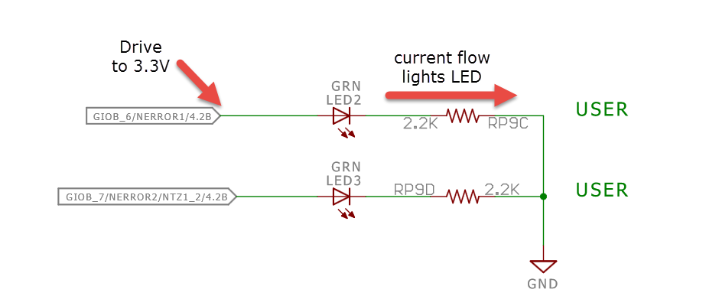
Objective:
Project 0 should be as simple as possible.
Our goal is to blink one of the User LEDs (LED2)
From the schematics we can see that LED2 is controlled by pin GIOB[6]
To turn on the LED – we need to drive GIOB[6] to 3.3V (logic 1) so that current will flow through the LED to ground, emitting light.
The 2.2K Ohm Resistor RP9C limits the current flow to protect the LED from damage..
Let’s get Started!

Slide 3


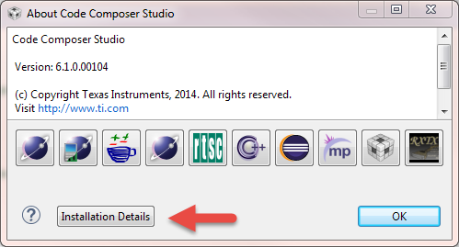
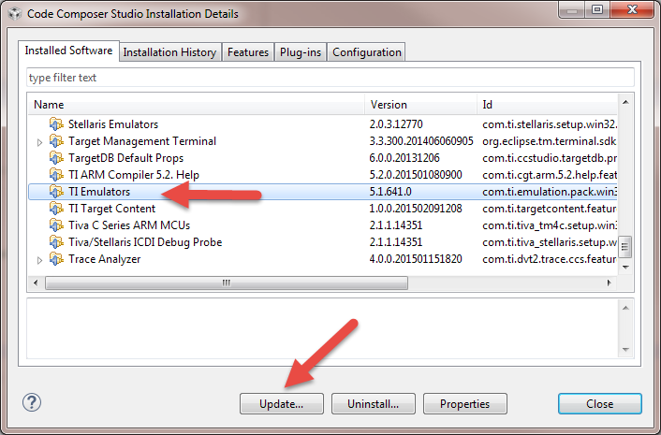
Required Software (Free Downloads)
CCS (Code Composer Studio) v6.1 or Later
HALCoGen v. 4.0.4 or Later
After Installing Code Composer Studio, Please confirm you have:
TI Emulators 5.1.641.00 or Later
Hercules Emulation 6.0.7 or Later
You can check the version of these components through CCS.
Launch CCS, select Help->About and then press the Installation Details button. The versions of all installed components will be listed. Update if Necessary.

Slide 4
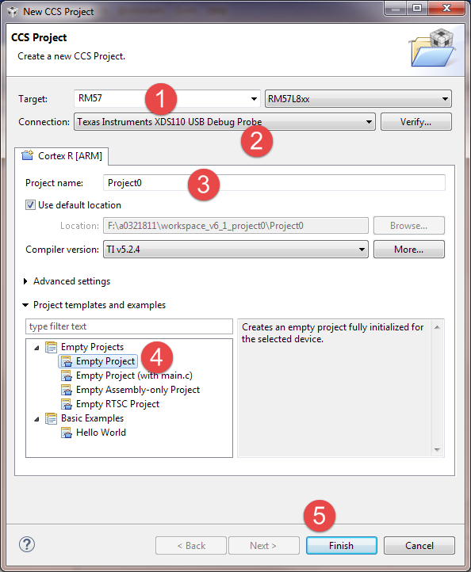
Create a CCS Project
Launch CCS
Select Project -> New CCS Project
The New CCS Project Wizard Appears (left)
Select the RM57L8xx Target
Select the XDS110 Debug Probe
Give your project a name
Select Empty Project
Press Finish
NB: Make note of the CCS project location (greyed out) for the next step.

Slide 5
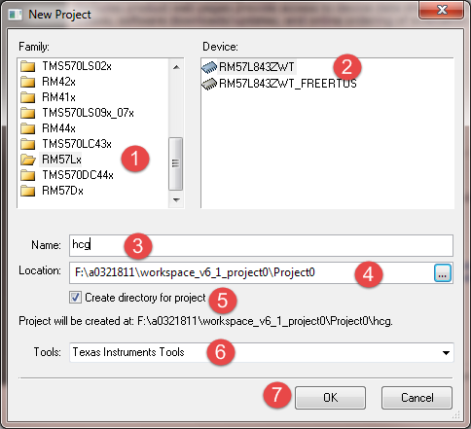
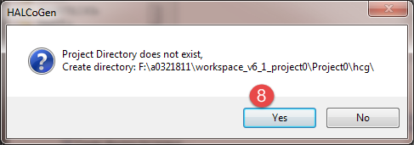
Create a HALCoGen Project
Launch HALCoGen
Select File->New->Project
The New Project Wizard Opens
Select Family = RM57L
Select Device = RM57L843ZWT
Name your project (hcg)
Select the CCS project location as the location of the HALCoGen Project as well (See prior slide)
Check Create Directory for Project
Select Texas Instruments Tools
Choose OK
Say “Yes” if asked to create the project directory

Slide 6
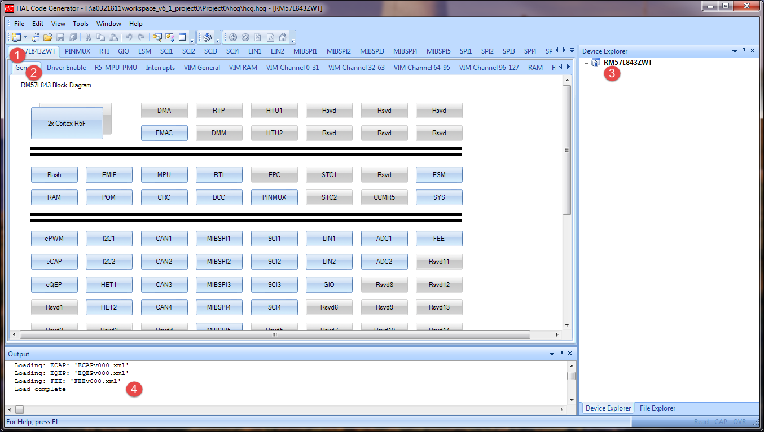
Your HALCoGen Project
HALCoGen should appear ready to configure an RM57L843ZWT:
Note how the device configuration is organized into 2 levels of tabs. The top level tabs (1) select the ‘Module” to configure. The 2nd level of tab breaks up module configuration into smaller steps (2)
Generated code will appear in the Device Explorer (3) (currently empty)
Pay attention to the Output pane (4) for any errors/warnings

Slide 7
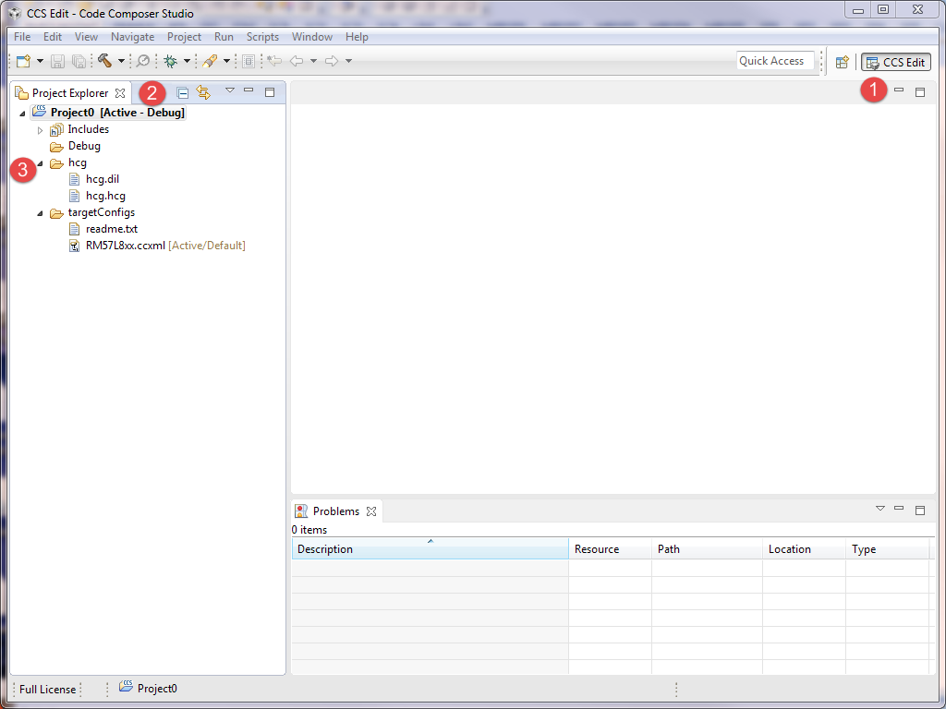
Check the CCS Project
From the “CCS Edit” Perspective…
View your project in the Project Explorer
You should have a subdirectory ‘hcg’ now for your HALCoGen project.
If not, repeat the steps on the last two slides.
Now you’re ready to generate the startup code for your project!!

Slide 8
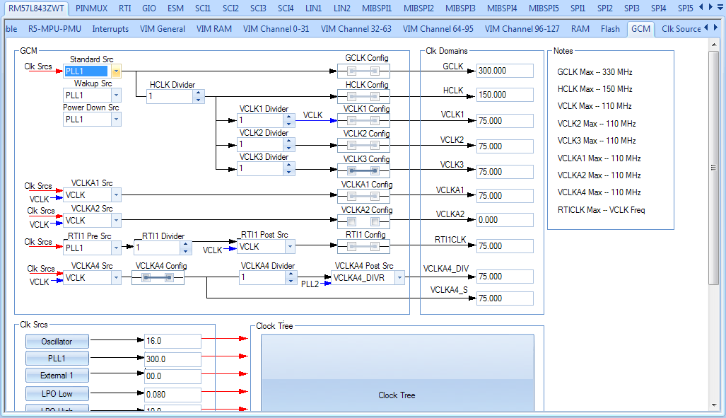
Back to HalCoGen
When you selected the RM57L843ZWT template for your HALCoGen Project – you automatically inherited a default device configuration.
You could press ‘F5’ and generate correct startup code for a generic “C” program that doesn’t interact with peripherals.
We want to blink an LED – so we need to make some changes. But first have a look at the various configuration screens to familiarize yourself with HALCoGen. (Don’t change any configurations yet).
For example, you can view the frequency map for the device from the RM57L843ZWT – GCM tab:

Slide 9
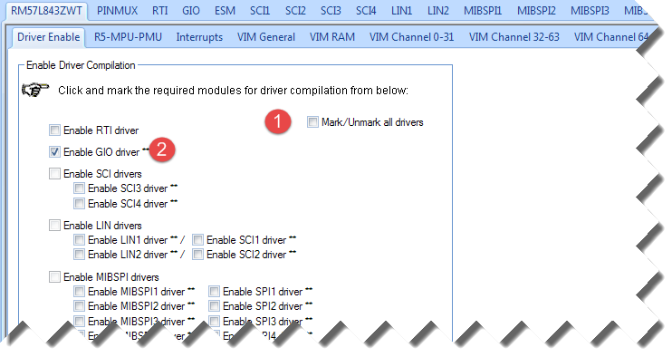
Begin Configuring the Device
Select the RM57L843ZWT -> Driver Enable Tab
All we need to do is control GIOB[6],
1) unmark all drivers
2) select only the “Enable GIO driver**” box.

Slide 10
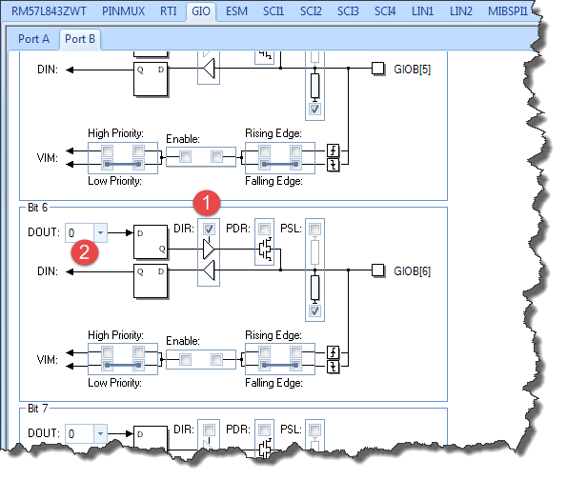
Configure GIO Port B
From the GIO Tab, Select Port B
1) Check the ‘DIR’ box for Bit 6 – to make GIOB[6] an output
2) Leave DOUT set to ‘0’ so that the LED will be off until we turn it on.

Slide 11
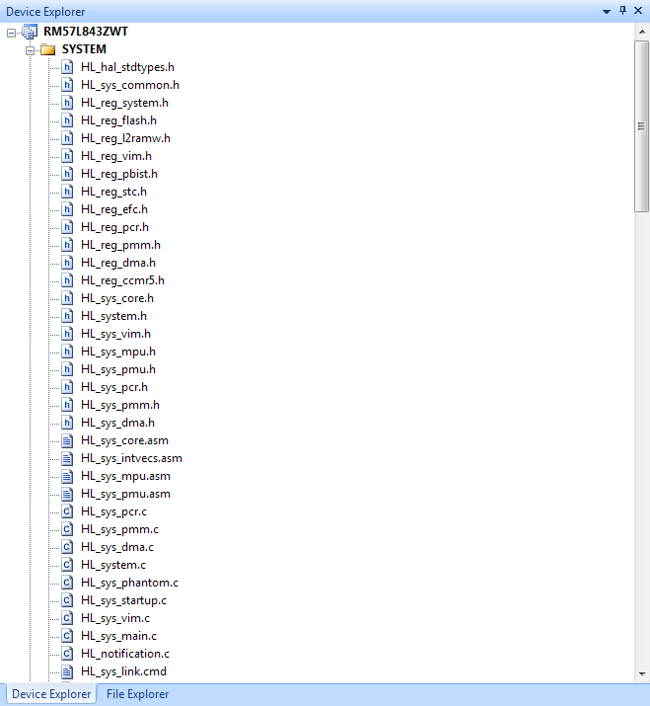
Generate Driver Code with HALCoGen
Save your HALCoGen Project
Press ‘F5’ or select File->Generate Code
Notice how many files HALCoGen has generated for you!

Slide 12
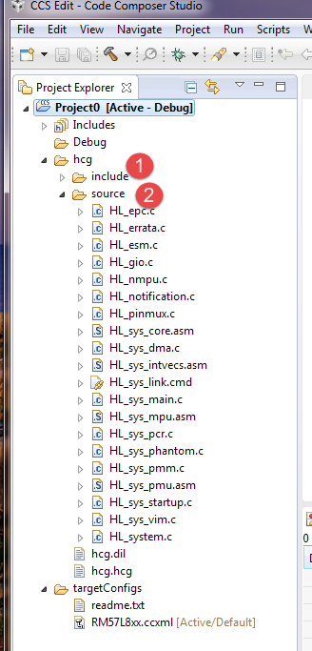
Switch back to CCS
Switch back to CCS – and check your project again.
Two new directories appear under ‘hcg’
1) ‘include’ – contains HALCoGen generated .h files
2) ‘source’ – contains HALCoGen generated “C” and assembly language sources.

Slide 13
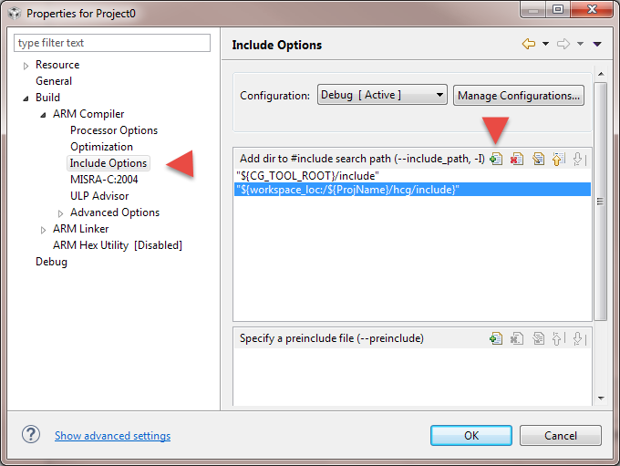
Update the Compiler Include Path
The compiler needs to be told to search hcg\include for header files.
With Project 0 Selected, Choose Project->Properties from the CCS Menu.
Navigate to Build->ARM Compiler->Include Options
Click on the Add Icon in the Add dir to #include search path pane.
Add "${workspace_loc:/${ProjName}/hcg/include}”
Select “OK”

Slide 14
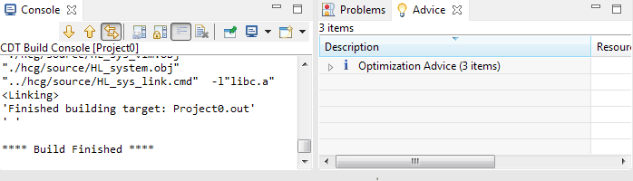
Confirm that your project builds
We haven’t added the code to blink the LED yet, but let’s make sure the project builds without any errors before moving on.
With your project selected, try Project->Build Project to make sure the build completes without errors.
If you see any errors show up in the “CDT Build Console” or in the “Problems” tab – check the previous steps. Otherwise you should see:

Slide 15
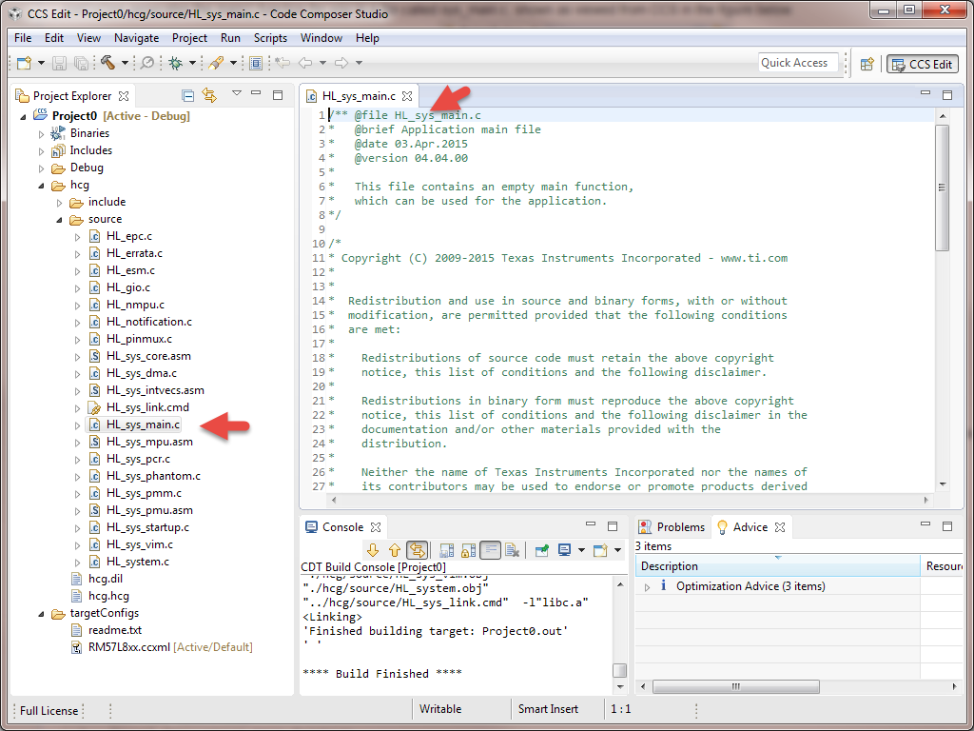
The main() function
HALCoGen generates a main() function for you in the file hcg\source\HL_sys_main.c
In the CCS project window, navigate to this file.
Double click on it to open it in the CCS editor.

Slide 16
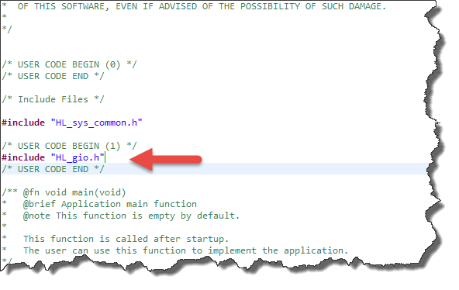
Add #include HL_gio.h
To call any HALCoGen gio driver functions from main, we need to first include the GIO driver header file – HL_gio.h
All code that we add should be added between /* User Code Begin */ and /* User Code End */ .
Code added between these comments will be preserved, even if we ‘Generate Code’ again from HalCoGen !
Tip: You can’t add new
USER CODE blocks,
You must work with those HALCoGen Provides.

Slide 17
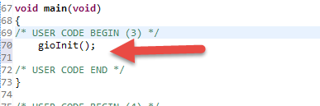
Add code to invoke gioInit()
Let’s add a call to gioInit() to main. When this function is called, our setting of GIOB[6] ‘Dir’ to Output will be applied.
Remember that we need to add our code inside a ‘User Code” block.
Tip: For most peripherals, <peripheral>Init() must be called. It’s common to forget this and an easy mistake to make.

Slide 18
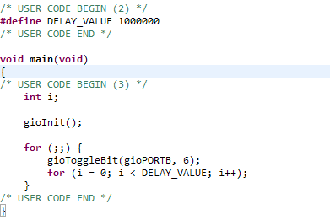
Add the ‘blinky’ code to main()
Now we’ll add a call to ‘gioToggleBit()’ inside a software delay loop – to implement the ‘blinky’ function.
Update your main() function so that it looks like this:

Slide 19
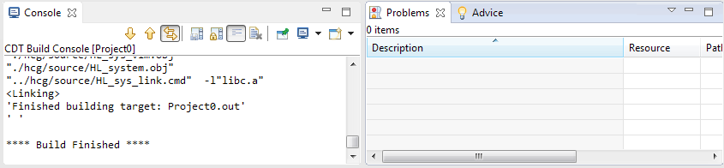
Build your project again
Now that main() has been updated with blinky functionality – it’s time to build your project again.
From the CCS Menu, select Project->Build Project
The build should complete again without errors. If you do have errors, now is the time to backtrack and check the previous steps.

Slide 20
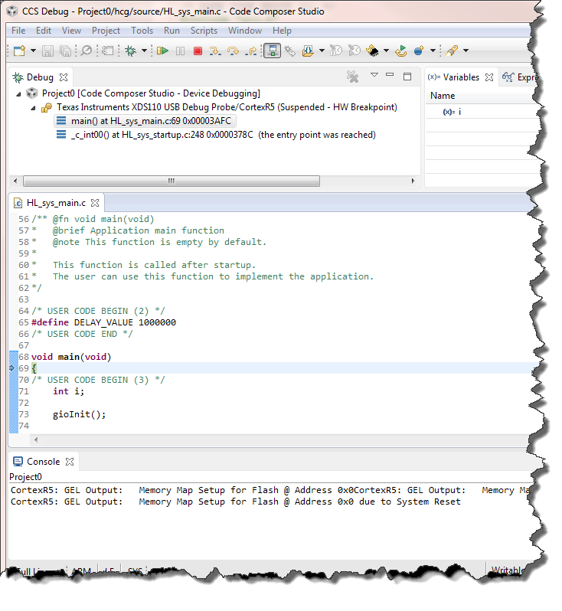
Launch a Debug Session!
Plug your launchpad into a USB port.
Launch a debug session by pressing “F11” or by selecting Run->Debug from the CCS Menu.
You’ll see the flash erased, then programmed with your application. This may take a few minutes as the flash is large!
When your program is loaded, it should automatically run to main() as shown on the right
Press Resume (F8) or and watch the LED blink!

Slide 21
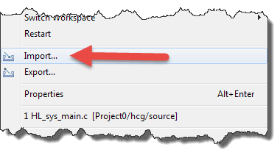
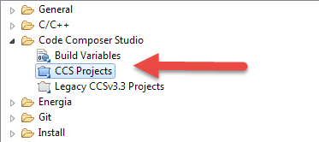
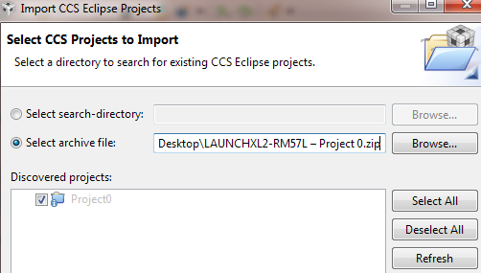
If you had trouble…
If you had trouble following these steps – we’ve also provided a completed project 0 that can be imported into CCS.
To import the project - select File->Import from the CCS Menu
Select the Code Composer Studio -> CCS Projects type.
Select ‘archive file’ and browse to the .zip file.
Choose “Project 0’ from the discovered projects
Press Finish
The project is already built and ready to debug

